Slide 1
The Gerardium Rush Optimal mineral recovery using a Genetic Algorithm approach
Team – pentlandite:
Njeumi, Alex N/ Tan, Peifeng/ Yongwen Chen/ Li, Zihan Ji, Geyu/ Cai, Mingsheng/ Sim, Melissa Y S
2024/05/20 - 2024/05/24
Notes:
Hi, we are team Pentlandite. Today we will present our project on optimizing mineral recovery using a Genetic Algorithm approach. This project aims to enhance the purity of valuable materials through optimise circuit designs involving separation units. We design an object oriented programming structure for this project, which enables users to modify the parameters and methods easily. We also have a corresponding post processing function to visualize the final result.

Slide 2

Presentation Structure
Genetic Algorithm
Circuit Modelling
Validity Checking
Optimum Circuit Configuration
Notes:
In this presentation, we will introduce the three sections of the project: the genetic algorithm, the Circuit modelling and the Validity checking of the circuit, and finally we will investigate the optimum circuit configuration with different economic factors.

Slide 3
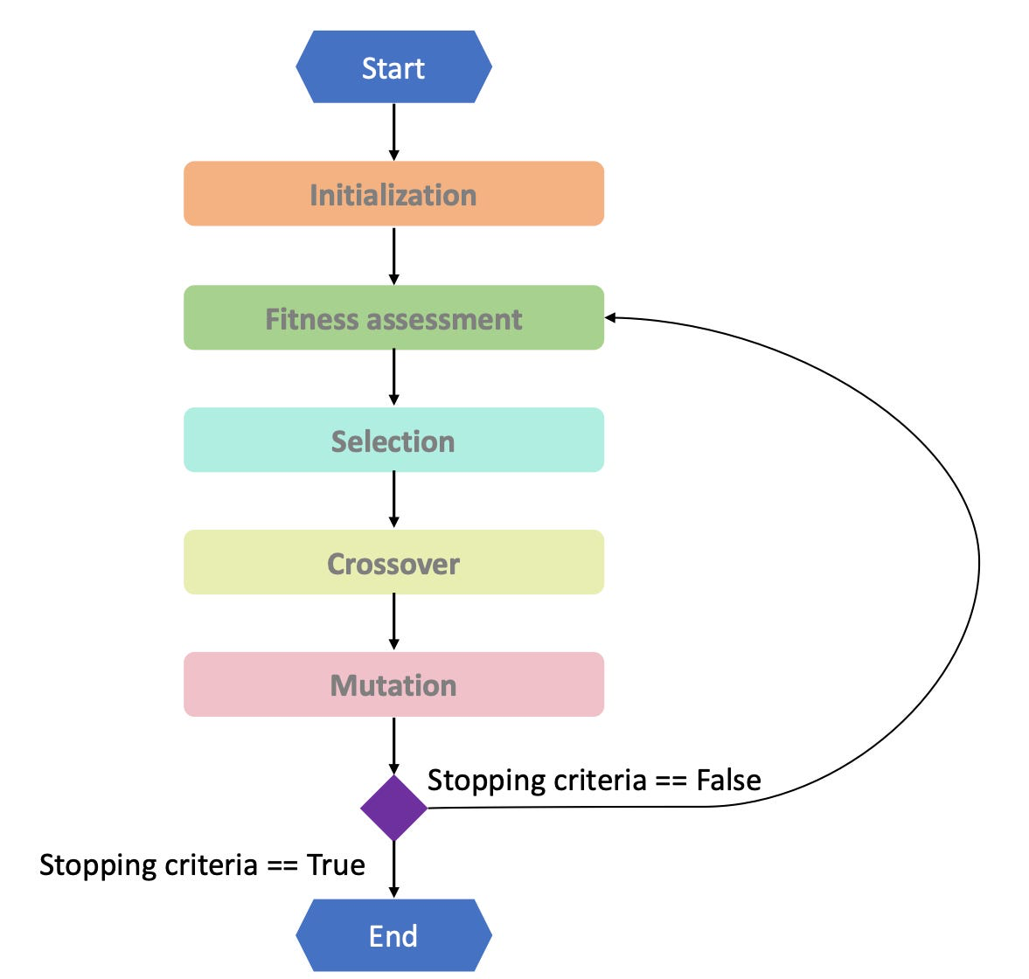
Genetic Algorithm
Solution method
Optimisation
OpenMP
parallelisation
Notes:
Let’s start with introducing Genetic Algorithms, which is the core optimisation function for finding the best circuit arrangement. The procedures of the algorithm is given here.
The Genetic Algorithm starts with an Initialization phase, where a diverse population of circuit configurations is generated. Individual undergoes a Fitness Assessment based on their fitness function and validity checking. We will discuss more about these evaluation functions in later sections.
Click
The core process involves Selection, Crossover, and Mutation. During Selection, the best candidates are chosen based on their fitness scores. Crossover combines parts of two parent solutions to generate new offspring, introducing new genetic combinations. Mutation introduces random changes to some genes, ensuring genetic diversity. We have various selection, crossover and mutation methods for users to choose. We will continue these processes until the stopping criterion is met.
Click
In terms of improvement, we use OpenMP parallelization for the expensive core process. This enhancement speeds up the algorithm by allowing multiple fitness assessments to run simultaneously, significantly reducing computation time.

Slide 4
Hybrid GA with Simulated Annealing
Probabilistic Acceptance
Reject
Offsprings
generation
SA Acceptance Mechanism
Accept
Notes:
P4
To further improve the algorithm, we hybrid simulated annealing with the offspring generation process of the Genetic algorithm.
Click
We apply the hybrid approach after generating offspring through Crossover and Mutation, we use the Simulated Annealing Acceptance Mechanism to decide whether to accept the new offspring or not.
Click
The mechanism uses a probabilistic acceptance criterion. It accepts new offsprings when their fitness is higher. When an offspring has lower fitness than its parents, it can still be accepted based on a calculated probability. This helps maintain diversity and prevents premature convergence.

Slide 5
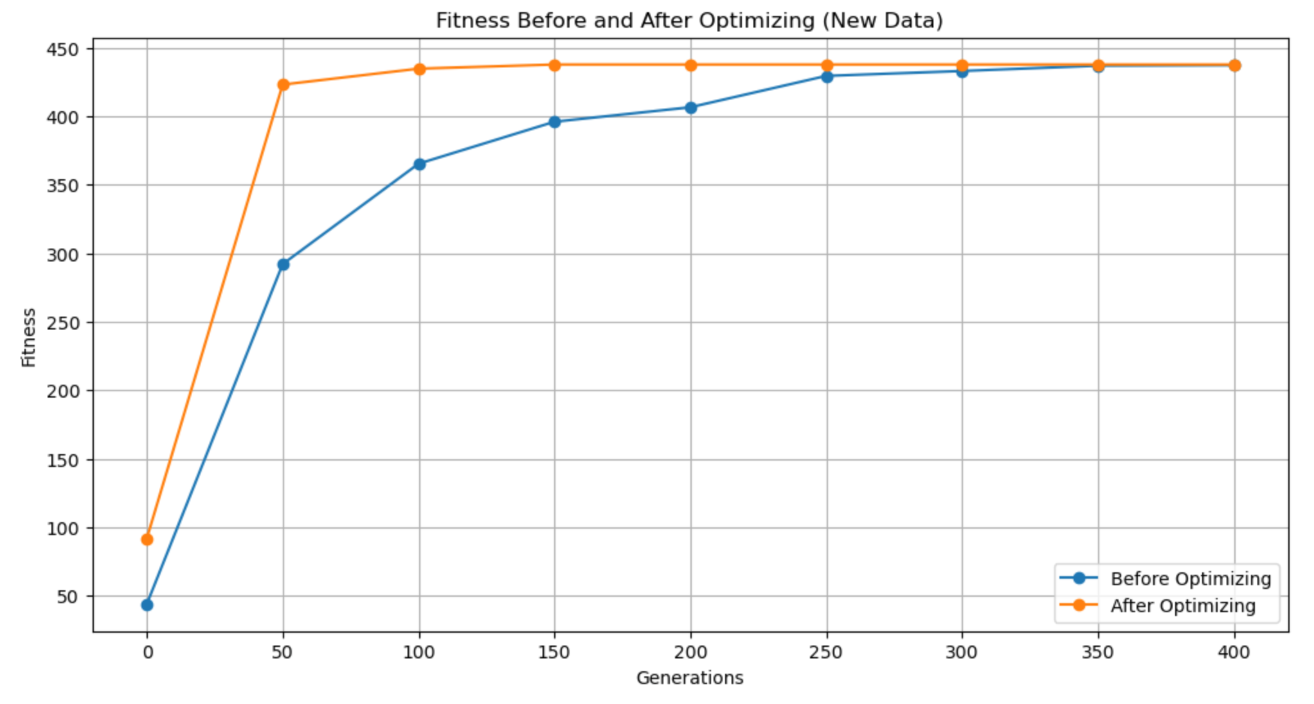
Hybrid GA with Simulated Annealing
Probabilistic Acceptance
Faster Convergence
Notes:
By choosing the high-fitness generated offsprings, and accepting worse solutions occasionally, the algorithm explores a broader solution space, increasing the chances of finding the global optimum. As shown in the graph here, compared to the pure Genetic algorithm, the hybrid version achieve faster convergence to high-quality solutions and avoid stucking in the local maximum.

Slide 6
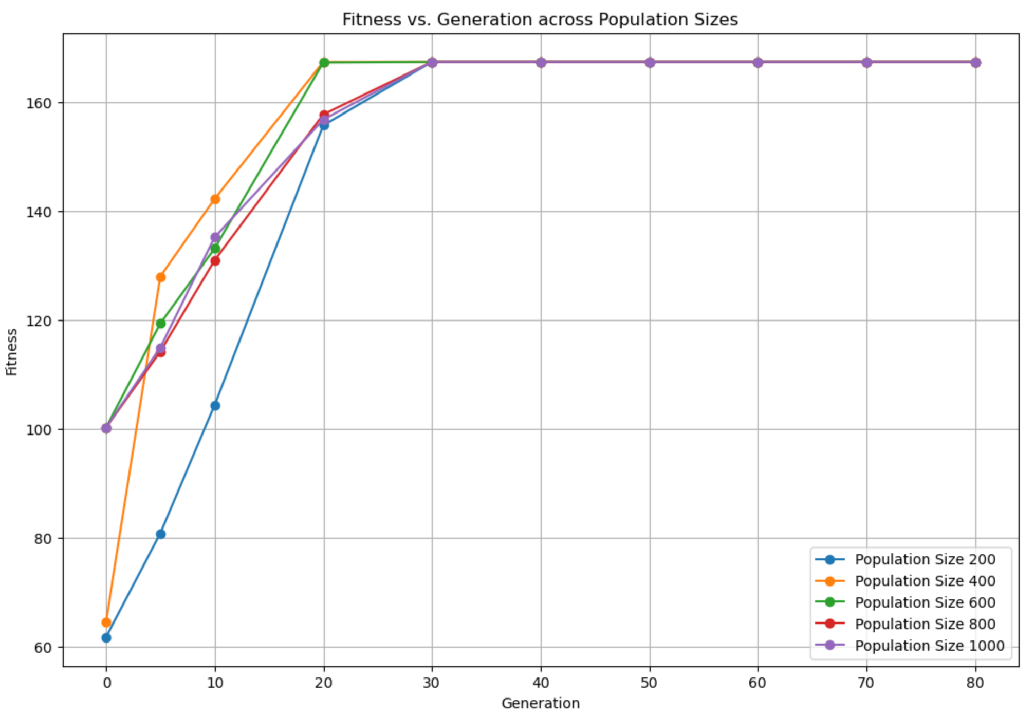
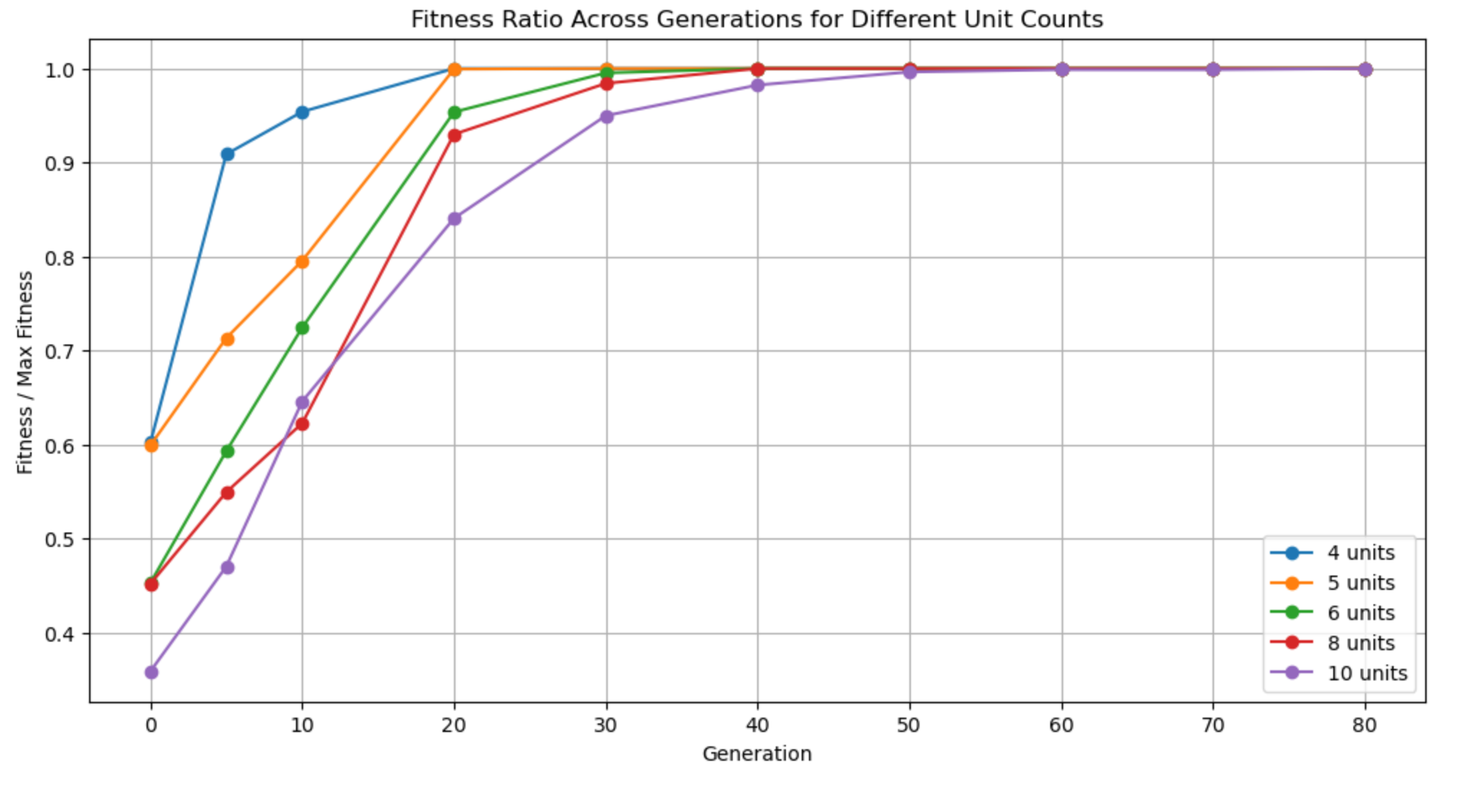
Investigation of Speed and Robustness
Population size
Vector size
Notes:
We now investigate the performance of the algorithm with various population sizes and the length of vectors. The graphs illustrate fitness versus generations. Both graphs find high-quality solutions within a small number of generations, and a larger population size and a smaller vector size converge more quickly to optimal solutions.

Slide 7
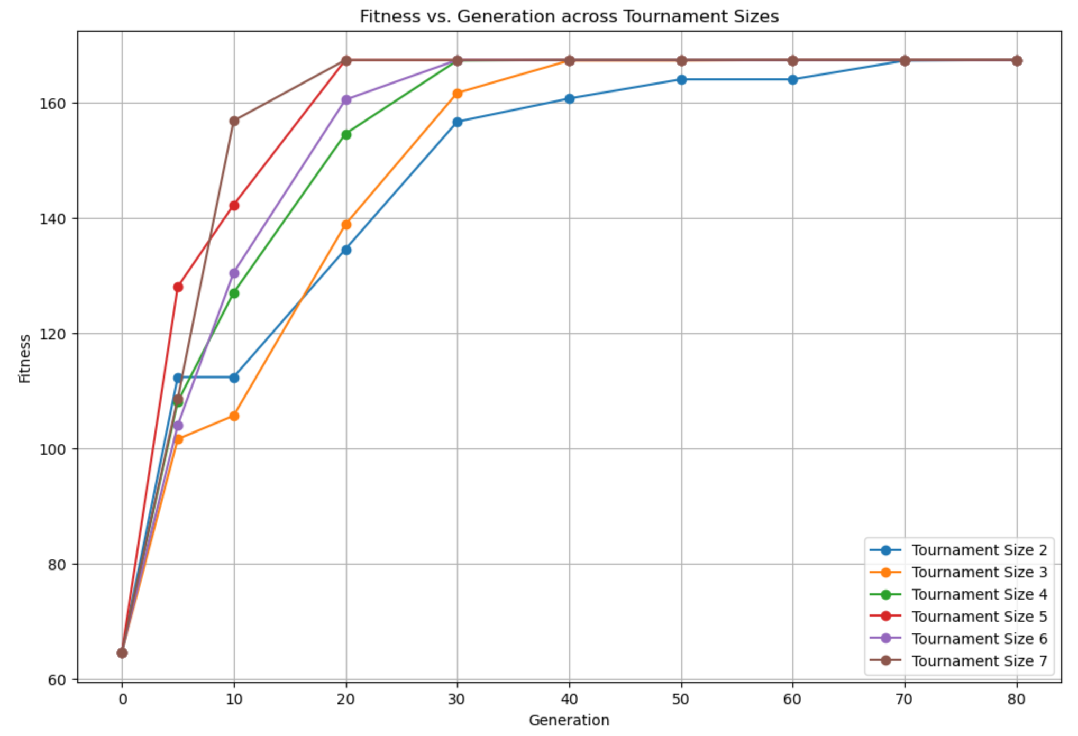
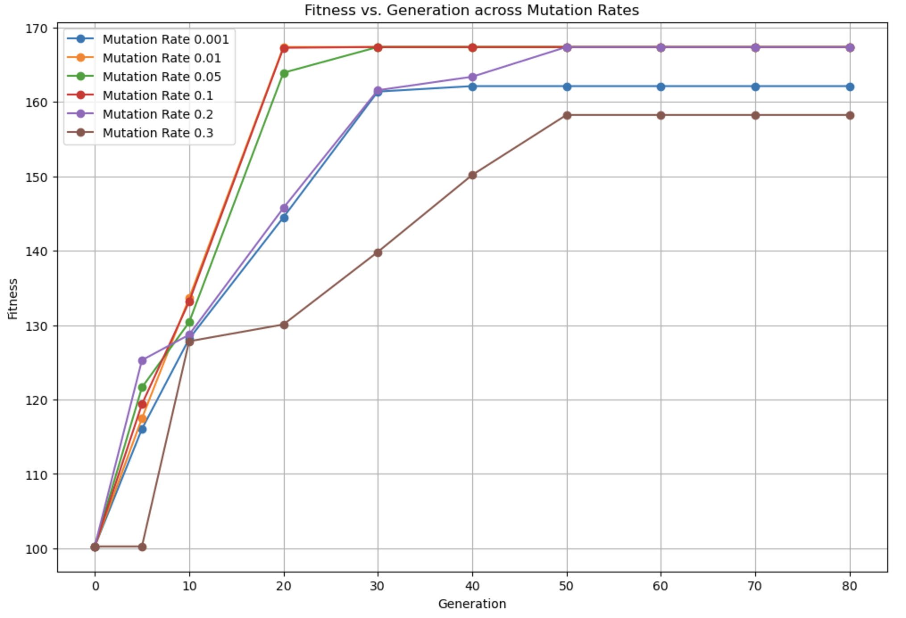
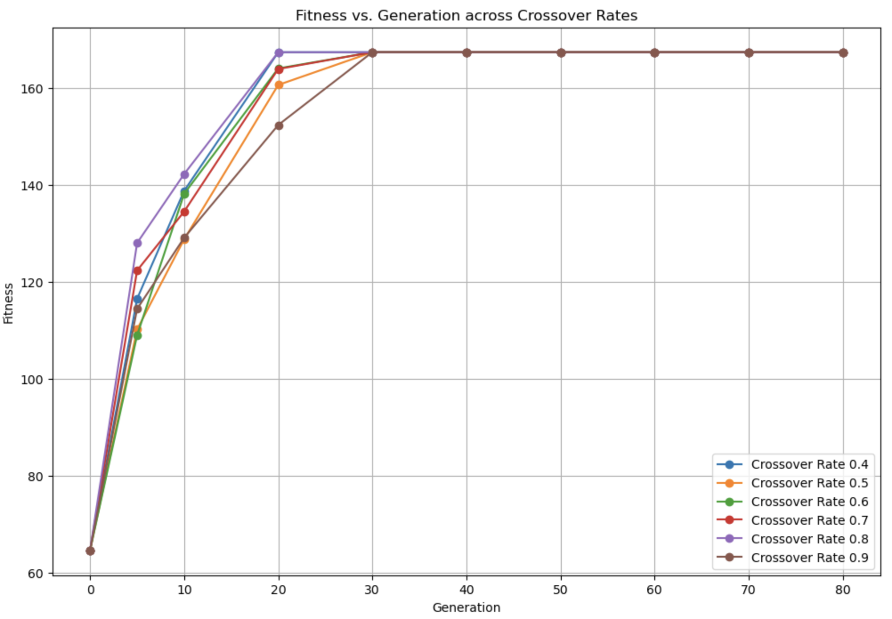
Parameter Investigation
Tournament Size: 5
Mutation Rate: 0.01
Crossover Rate: 0.8
Algorithm_Parameters params(1000, 400, 5, 0.8, 0.01, 0.01, 0)
Notes:
We also investigate other algorithm parameters on their speed of convergence and robustness. We analyse the impact of three key parameters: Tournament Size, Mutation Rate, and Crossover Rate here. All of them could converge successfully, though the final fitness could be influenced by the mutation rate. We use these results for parameter tuning. With the tuned parameters, our GA algorithm is able to applied to various circumstances with a high convergence speed and robustness.

Slide 8
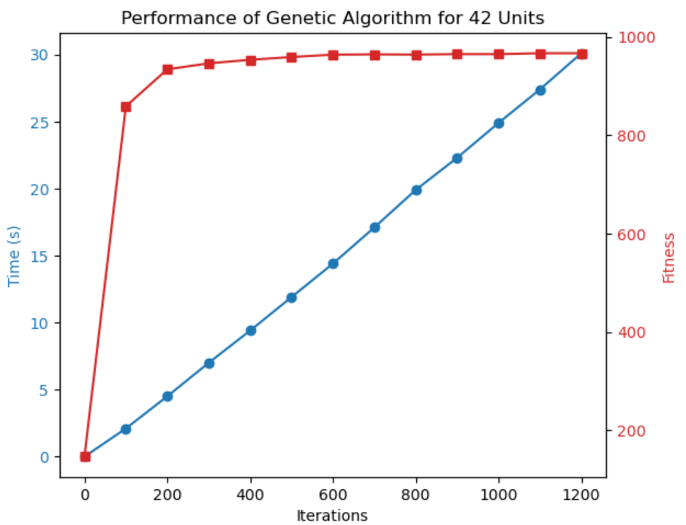
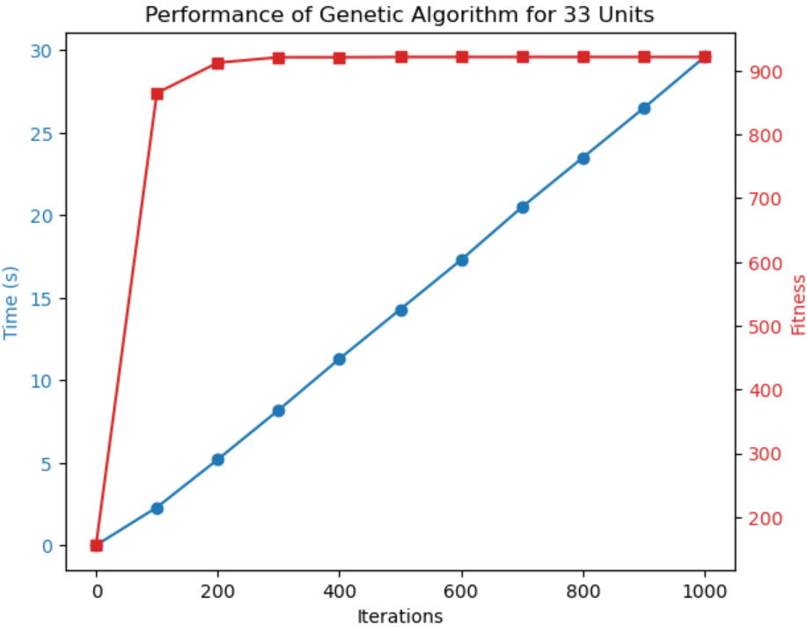
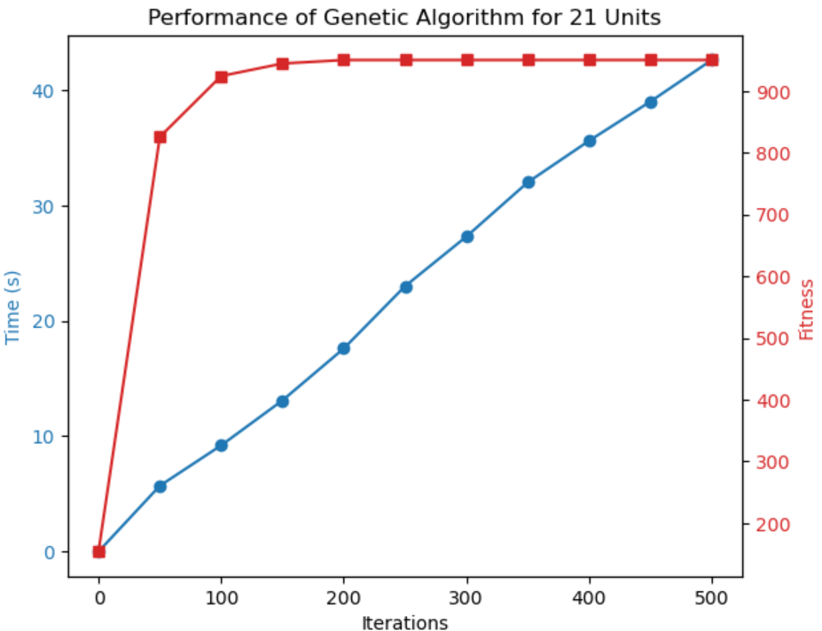
Optional Large Circuit Problem
Challenge 1: 967.113
Performance: 967.113
Time: 27.4 s
Challenge 2
Performance: 921.623
Time: 17.3 s
Challenge 3
Performance: 950.073
Time: 15.6 s
Notes:
Our function could also handle large circuit problems. These three graphs shows that we could converge to a nice solution within a short time for all the challenges.

Slide 9
Performance of the Genetic Algorithm
Speed of convergence (how it scales with number of units)
Robustness of final solution (precision of results) 100%
How the genetic algorithm affects this

Slide 10

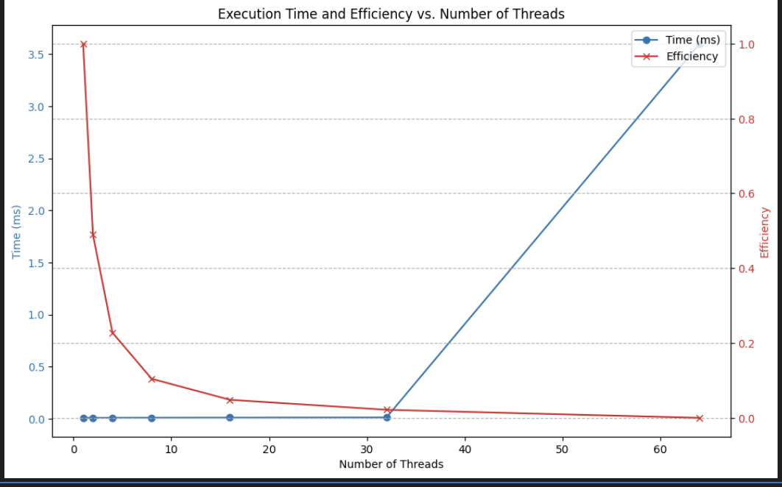
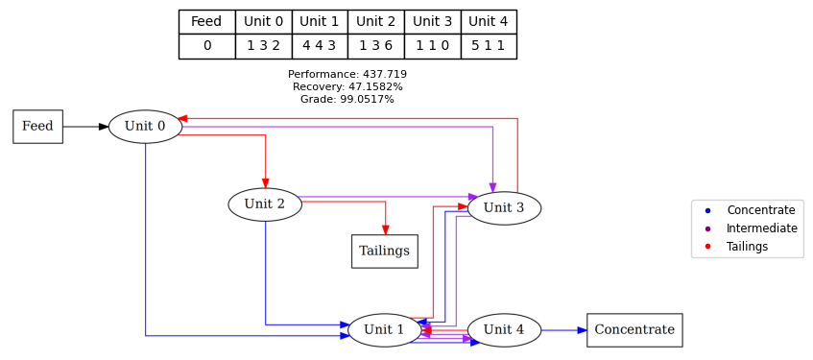

Circuit Modelling
Evaluate circuit
Check convergence
Performance
Notes:
today I'll briefly overview the Evaluate_Circuit function in the CSimulator class, which is key to simulating and evaluating circuit performance.
The Evaluate_Circuit function performs these tasks:
Initialization: Sets up parameters and the simulation environment, including initial feed rates for gerardium and waste.
Steady-State Solution: Iteratively solves for the steady-state mass balance, with each iteration depending on the previous one. During each iteration, the function:
Calculates Flows: Determines the flow rates of gerardium and waste through each unit.
Checks for Convergence: Uses a tolerance parameter to check if the current iteration has converged based on changes in the flow rates. If the system converges for a specified number of consecutive iterations (5 in this case), the process stops early.
Performance Evaluation: Calculates overall performance by weighing the concentrate's gerardium and waste content, focusing on recovery rate and grade of gerardium.
We chose a sequential implementation over parallel processing for several reasons:
Iterative Dependency: Each iteration relies on the previous iteration's values, ensuring accurate updates.
Convergence Control: Easier to manage in a sequential setup, especially when implementing convergence checks.
Simplicity and Debugging: Easier to understand, debug, and maintain.
Performance: The chart shows our sequential execution is already efficient. Adding parallel processing would increase overhead without significant gains. Efficiency decreases with more threads, indicating diminishing returns.
In summary, the Evaluate_Circuit function effectively models circuit performance with a straightforward, efficient sequential approach.

Slide 11

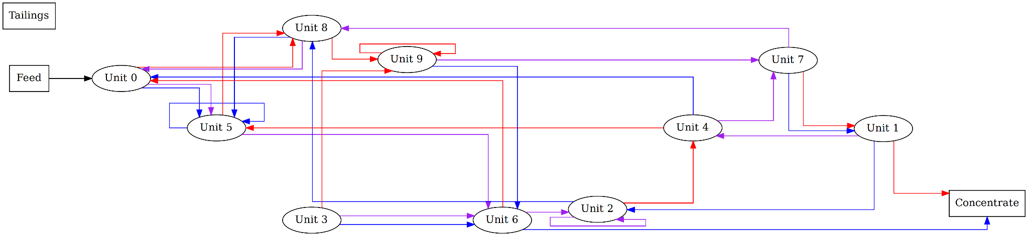
Validity Checking
Legend
C_stream = Concentrate stream
I_stream = Intermediate stream
T_stream = Tailings stream
No path to the outlet
C_stream and T_stream with same destination
Self - recycling
Not accessible
T_stream into Concentrate outlet
Notes:
No self recycling
Check that there’s at least one tail stream connected to tailing outlet and same for concentrate
Check that concentrate stream doesn’t go to tailing unit and tailing stream doesn’t go to concentrate unit
Check that concentrate and tailing stream doesn’t go to same unit
Check that each unit is accessible from feed
Vector is always multiple of 3 + 1, this checks that each unit (excluding the concentrate and tailing) have 3 output streams
No negative numbers or numbers which are larger than the number of units +1
Feed is not the concentrate/tailing units

Slide 12

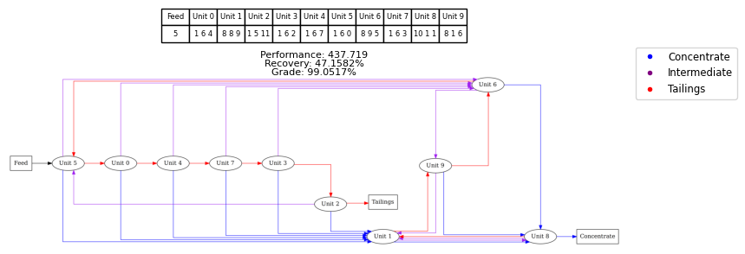
Base Case Solution
Notes:
For the base case circuit solution, we observed several features: 1. A row of units which handles further filtering of the tail streams. (shown by the red circle)
2. A unit which takes in the concentrate streams from the row of units. (shown by blue arrow)
3. A unit to handle one last filtering of the material before sending to the concentrate (Unit 8)
4. A unit which takes in the intermediate streams from this row of units, recycles its tailing to the start of the row of units and directs its concentrate stream towards the concentrate (shown by the purple arrow)
5. And a unit which allows recycling of material midway through the circuit (Unit 9)

Slide 13
Optimum Circuit Configuration vs Economic Factors
Number of units in the circuit
Circuits with 5-15 units investigated
Price paid per gerardium relative to waste
£1000/kg reward, £500/kg reward
£7500/kg penalty, £3750/kg penalty
Purity of input feed
10-90% gerardium to waste
Notes:
To observe the effects of economic factors on the optimum circuit configuration the above factors were varied with their respective ranges listed in the slide.

Slide 14
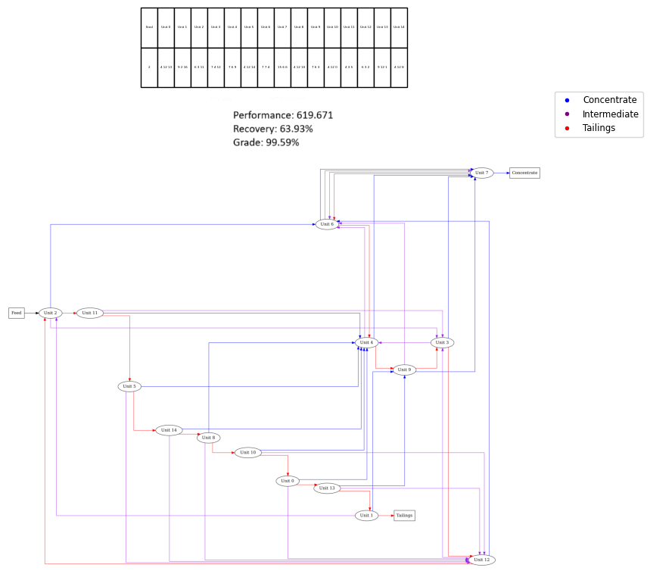
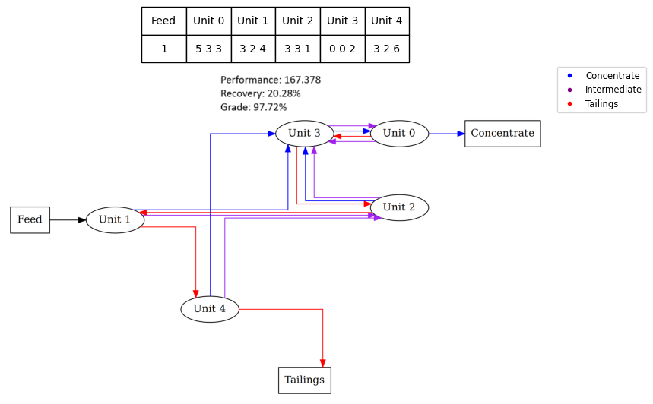
Number of Units in Circuit
5 units 15 units
Notes:
We investigated for a range of 5-15 units in a circuit.
Generally, circuits with a different number of units have a similar structure to the base case seen earlier, this is pointed out by the red circles for the row of units, blue arrows for the unit which handles their concentrate streams and purple arrows for units which handle their intermediate streams.
Circuits with more units, also have units which handle recycling of intermediate streams and further filtering of both the tailing and concentrate streams before depositing into the final concentrate and tailing, as seen in the base case and the circuit with 15 units (shown in green).
For circuits with fewer units, there might be insufficient units to have additional further filtering and therefore these features are not as obvious/not seen at all.

Slide 15
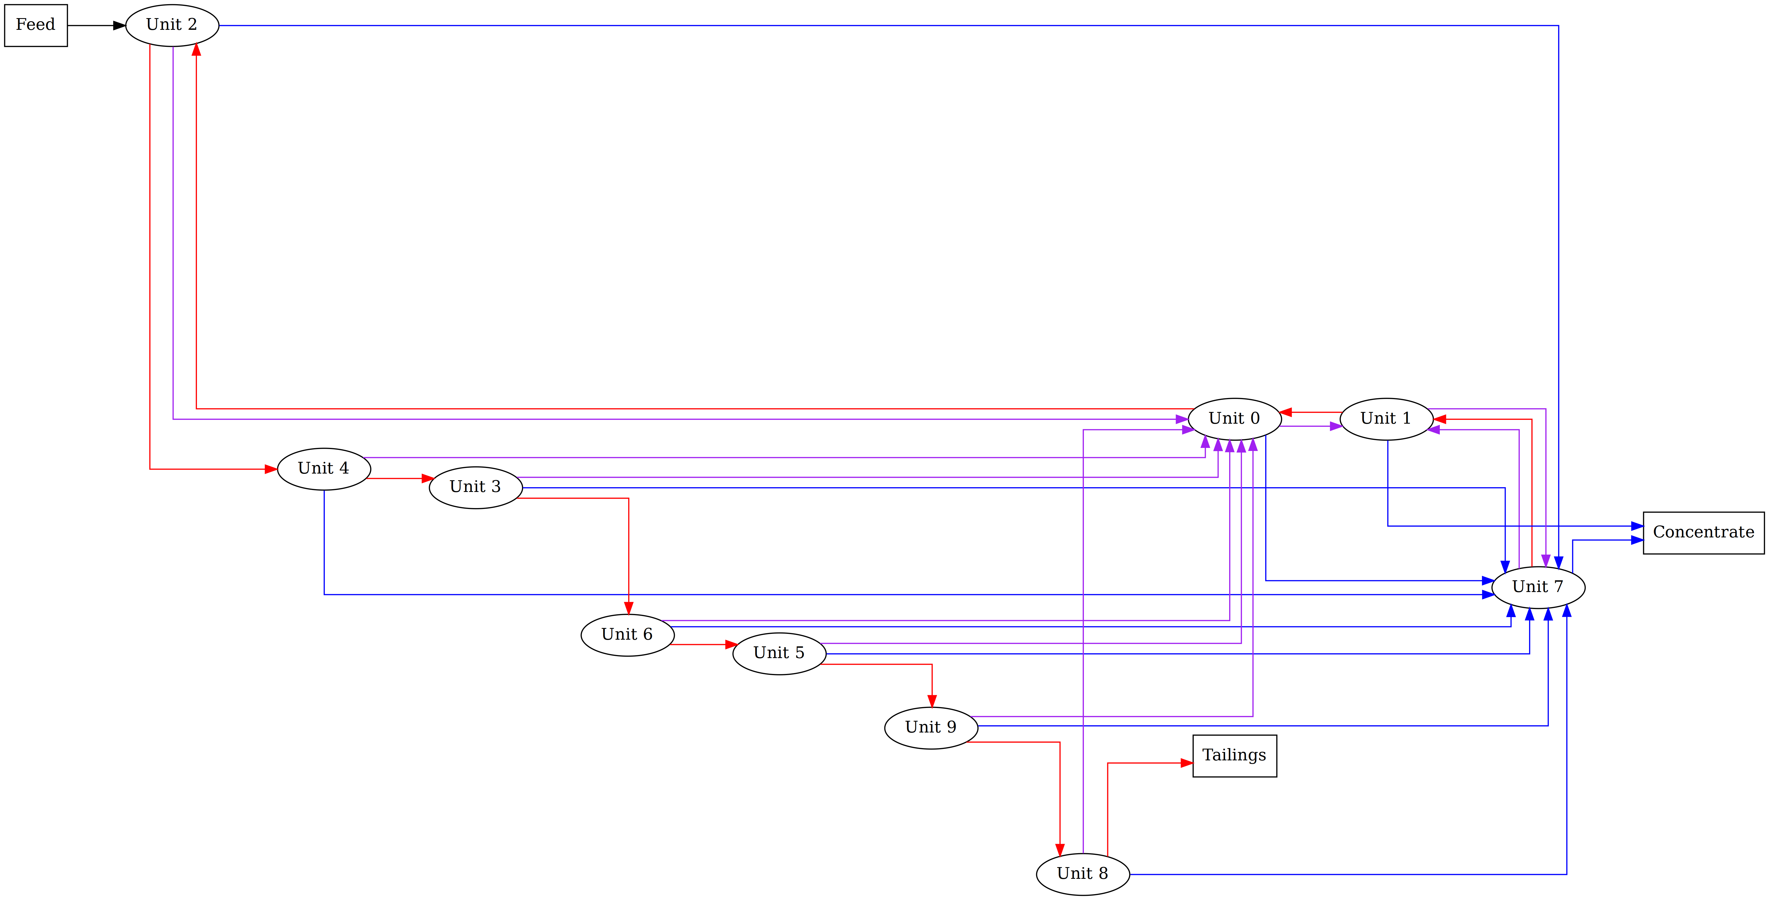
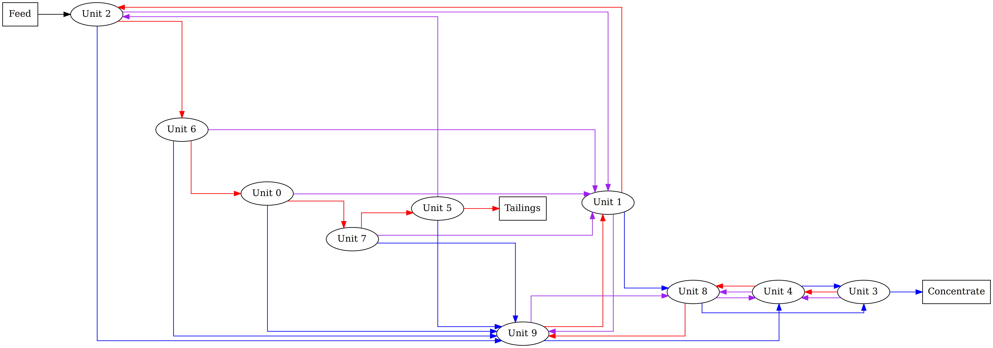
Price paid per gerardium relative to waste
Higher reward Higher Penalty
Notes:
We investigated for a range of 10x the penalty, 5x the penalty, 5x the reward, 10x the reward
The same general structure mentioned earlier was observed for the different degrees of penalities and rewards
However, some differences were also highlighted, for higher rewards there were more units to filter the tailing stream row (shown in red), this is expected as the circuit is rewarded for extracting as much valuable material prior to deposal
For higher penalties, we observed more units to filter for the concentrate stream, (shown as the blue box) again this is expected as the circuit prioritises filtering out as much waste from the stream leading to the concentrate.

Slide 16
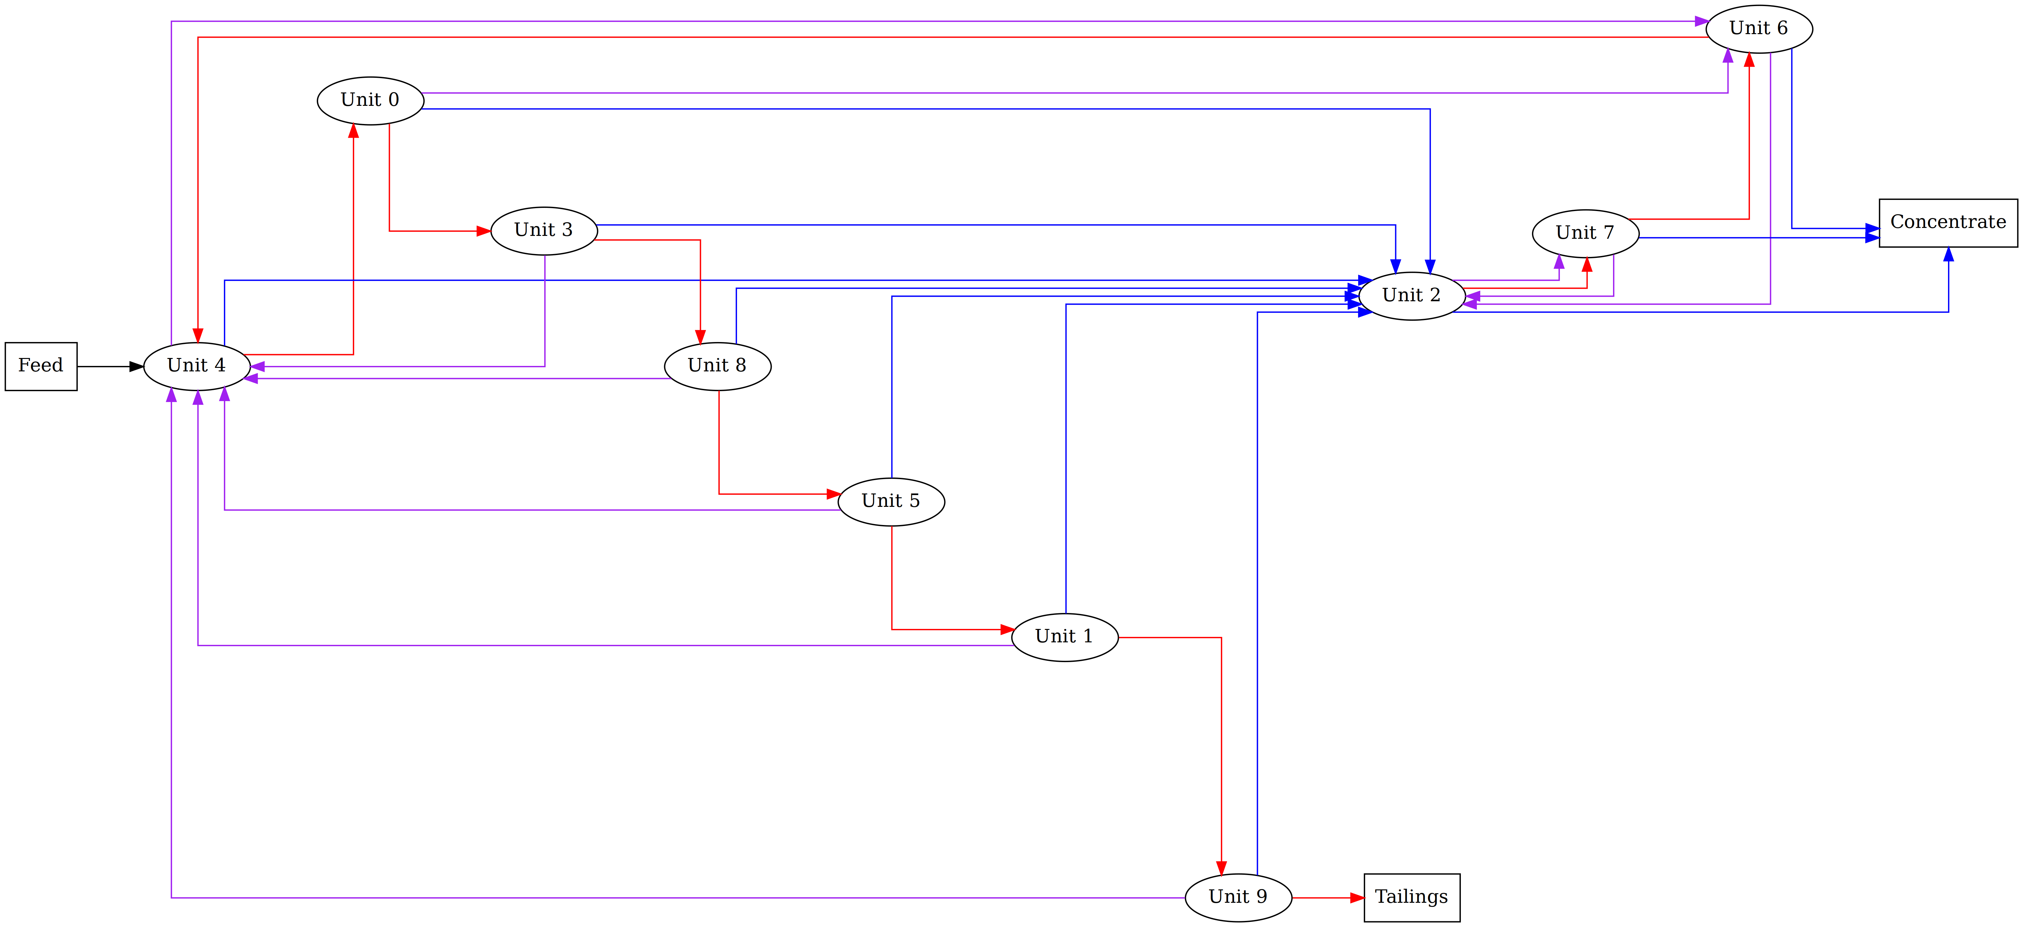
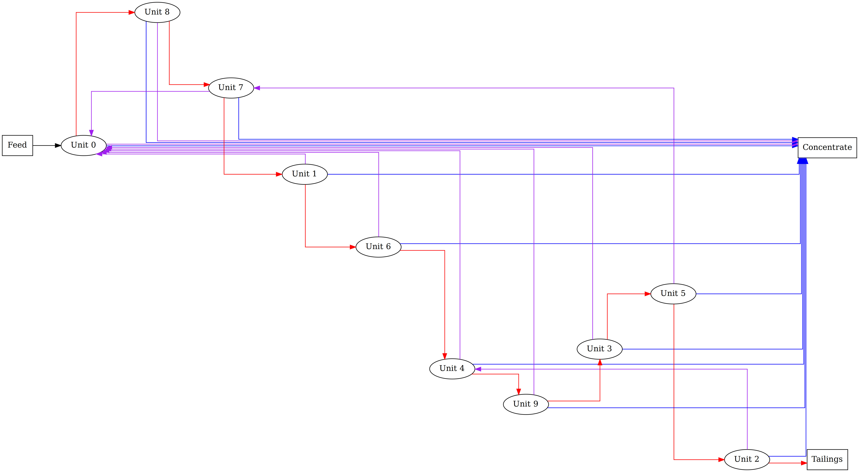
Purity of Input Feed
30% gerardium 90% gerardium
Notes:
Lastly, we investigated input feed purities of 10%-90% with 10% intervals
Like the prior economic factors, the same general structure where a row of units filter out the tailing stream can be observed over the range of purities explored:
When varying the purities of the input feed we observed:
For higher purities, the intermediate streams close to the start of the row of units directly connect to the concentrate outlet, This can be seen on the diagram to the right for Units 0 and 8, while the other units recycle their intermediate streams to the start of the row
- This could be because the purity of the intermediate streams are higher and there’s less waste content in these streams at the start of the row compared to further down the row
We also observed more units in the tailing stream row for circuits with higher purities, in the example above for 90% there were 10 units in the row, while for 30% purity there were 7 units, the other 3 units were utilized to further filter the concentrates, before deposition

Slide 17
Heuristic Circuit Design Elements
A row of units which filters out tailing stream leading to the tailing
A unit to handle concentrate streams from this row of units
A unit to handle intermediate streams from this row
Additional considerations:
Additional filtering
Reward gained/penalty cost
Purity of feed
Notes:
Based on the above observations, there are some similarities in the circuit which can be leveraged to create a heuristic design
Common features include: 1. Having a row of units to filter out the tailing streams eventually leading to the tail.
2. A unit to handle concentrate streams from this row of units.
3. And a unit to handle the intermediate streams
Some things to take into consideration based on economic factors are:
4. If additional units available can be added for further filtering 5. Depending on the penalty cost, we can arrange more units before the concentrate deposition for higher penalties or arrange more units to filter out the tailing stream for cases with higher rewards
6. And the purer the input feed the more units we can assign to the tailing stream row (to extract as much valuable material from waste before deposal)

Slide 18
Future Work
Hybrid with crowding distance for the genetic algorithm
Circuit modelling code structure, move the compute function into the unit class, to have better structure for better understanding of the principal of the model.
Validity checking, with our analysis of the optimal circuit configuration, there are certain checks we could add.
Notes:
- These are a few improvements we could make with our program in the future to help improve its overall performance and structure:
- For the genetic algorithm, integrating crowding distance in our genetic algorithm could help enable us to keep a diverse parentage ensuring the population does not become too concentrated in a certain area and doesn't get stuck in a local minima
- For the circuit model we could improve the code structure by implementing the compute function in the unit class instead of the circuit class, this shows a better understanding of the model
- To further the efficiency of the program m, we could implement stricter validity checks based on the common patterns observed in the optimal circuit configurations to help navigate the algorithm towards a convergence

Slide 19
Thanks for your time!!! Group: Pentlandite

